Slide 1


Slide 2


Slide 3
Unit-7
Preconceptional care

Slide 4


Slide 5
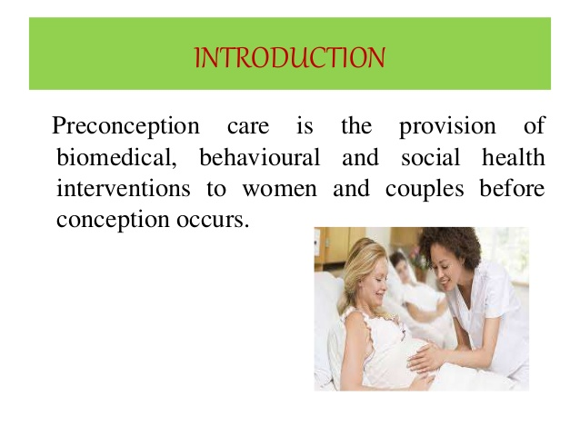

Slide 6
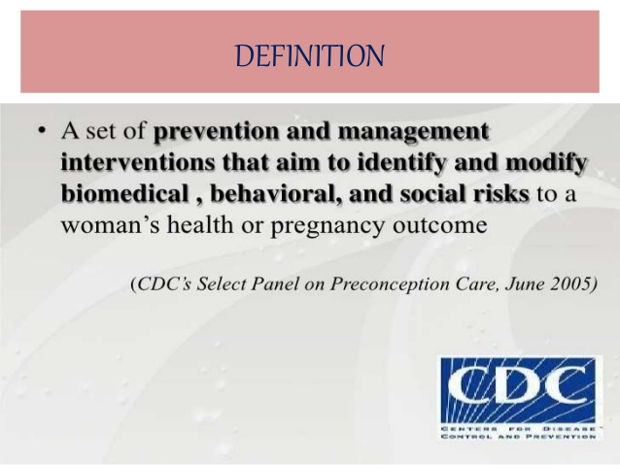

Slide 7
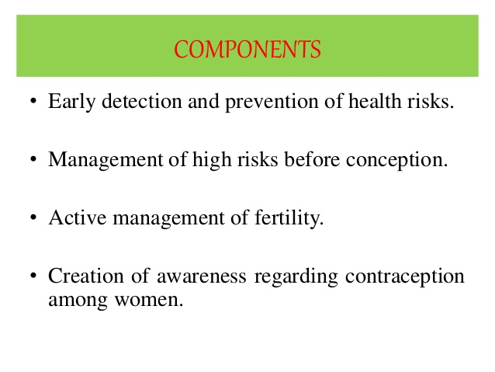

Slide 8
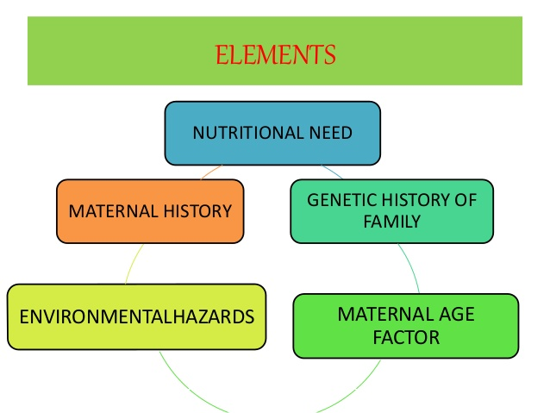

Slide 9
objective
To ensure that a woman enters pregnancy with an optimal state of health this would be safe to both herself and the fetus.

Slide 10
Component of preconception counseling
Systematic identification of preconceptional risks through assessment of reproductive, medical, social, family, histories. Ask nutritional status,socio environmental conduction drug and other chemical exposure.
Provision of education based on risks.
Discussion of genetic concern and reffered

Slide 11
Determination of hepatitis status, and immunization if indicated.
Nutritional counseling on appropriate weight for height, sources of folic acid.
Laboratory tests if indicated.
Discussion regarding desired birth spacing and perceived barrier to achieving, including contraceptive use.
Emphases on importance of early, and continuous prenatal care.

Slide 12
Preconceptional care
It is an integral part of antenatal care, because this care program has potential to assist women by reducing risk, promoting healthy lifestyle, and improving readiness for pregnancy. Factors that could potentially affect perinatal outcome are identified and the women are advised about the risk involved.

Slide 13
Goal of the preconception care
To provide health promotion, screening and interventions for women of reproductive age to reduce risk factors that might affect future pregnancies.
To provide a woman and her husband with information that can help those to make timely informed decisions about future pregnancies.
to promote her health and the health of her children throughout her reproductive life span.

Slide 14
Strategies
To improve both men’s and woman knowledge, attitude and behaviors related to preconception health.
To ensure that all women of childbearing age receive preconceptional care service screening health promotion and intervention that will enable them to begin pregnancy to optimal health.

Slide 15

To reduce risks indicated by prior adverse pregnancy outcome through interventions.
To reduce the health disparities in adverse pregnancy outcomes.

Slide 16
Advantages
it provide the opportunity for primary prevention of some congenital anomalies other complication of pregnancy.
It offers as ideal time to educate the woman about the advantages of planning her pregnancy.

Slide 17


Slide 18
Component of preconception care
The components of preconception care including an any intervention to adress medical psychological and environmental risks associated with childbearing age. Particularly those that are a part of preconception care should include counseling on appropriate medical care and behavior to optimize pregnancy outcome.

Slide 19
Health promotion(general teaching)
Risk factor assessment(identification of risk factors)
Intrevention: treatment of medical conditions
Recommendation for preconceptional health and pregnancy outcome.

Slide 20
Health promotion
Nutrition (healthy diet) including folic acid. Folic acid supplementation at least 500microgram a day starting 4 weeks prior to conception up to 12 weeks of pregnancy is advised. This can reduced the incidence of neural tube defects.
Exercise and rest.
Avoidance of substance abuse.
Use safer sex practice
Attending of family and social needs.
Fear of the incoming pregnancy is removed by preconceptional education.

Slide 21
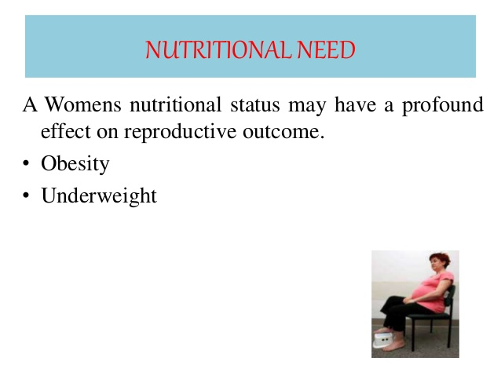

Slide 22
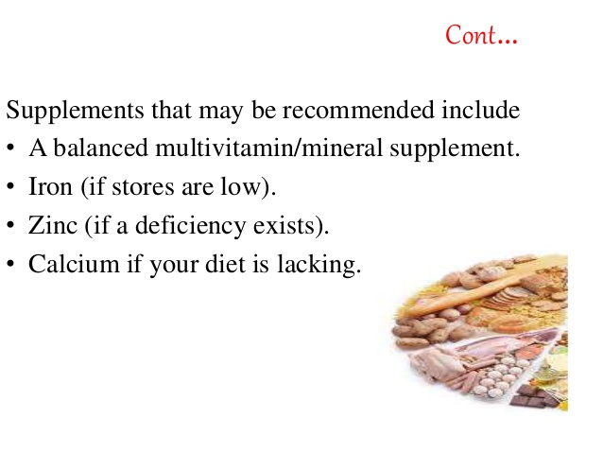

Slide 24
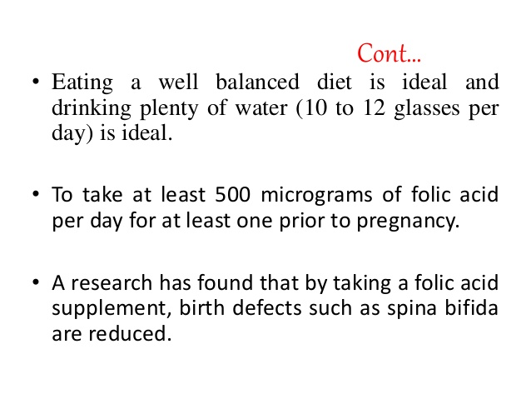

Slide 25
Risk factor assessment(identification of risk factors)
Medical history: the woman has dibetes mellitus, thyroid disorder, asthma, heart diseases, chronic hypertension,cancer, kidney disease, epilepsy, rubella and toxoplasmosis. Currently taking medicine(prescription or non prescription)
Family history
Reproductive history
Psychosocial history

Slide 26
Intervention : treatment of medical condition
Basic level health status including BP is recording.
Rubella and hepatitis immunization in non- immune women.
Folic acid supplementation 4mg(400mcg) a day starting 4 weeks prior to conception up to 12 weeks of prgnancy is advised.
Drugs used before pregnancy are varified and changed if required so as avoid any adverse effect on the fetus during the period of organogenesis.

Slide 27
Problem of overweight, underweight, anemia are evaluated and treated appropriately.
Patient with medical complications should be educated about the effect of the disease on pregnancy. In extreme situation, the pregnancy is discouraged pre existing chronic disease(hypertension, diabetes, epilepsy) are stablized in an optimal state by intervention.

Slide 28
Inheritable genetic diseases are screened before conception and risk of passing on the condition to the offspring.
Inheritable genetic disease can be managed either by primary prevention or by secondary prevention.
Couples with history of recurrent loss or with family history of congenital abnormalities are investigated and counseled appropriately.

Slide 29
Referral for genetic counselling and screening if needed.

Slide 30
Recommendation
All women and men of childbearing age have high productive awareness, e.g understanding risk factors related to child bearing.
All women have a reproductive life plan.
All pregnancies are intended and planned.
All women of childbearing age are screen prior to pregnancy for risks related to the outcomes of pregnancy.
Woman with a privious pregnancy loss have to access to intensive interconception care aimed at reducing risks.

